Slide 1

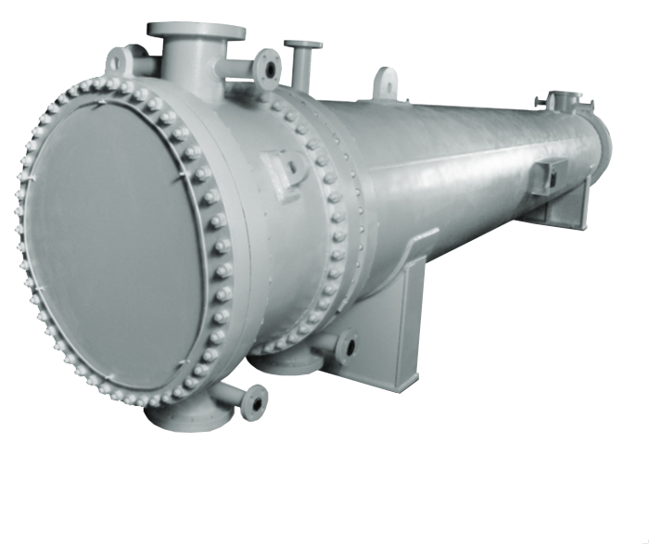
Shell and Tube Heat Exchanger
Photo by https://www.dhtnet.com/products/shell-tube-heat-exchangers/
Presented by : Usman Akram, Jeremy Baker, Jonathan Ferguson and Daniel Sigala

Slide 2
Overview of Experiment
In this experiment, a shell and tube heat exchanger is modeled and simulated to find the heat transfer rate of the heat exchanger and its efficiency..
We designed a heat exchanger using solidworks. A fluid simulation was done to see how the heat exchanger performed under ideal conditions..
The shell and tube design had an efficiency of .37 with a overall heat transfer of Q_{actual} =2.32 kW and theoretical heat transfer of Q_{theoretical}= 6.27 kW.
Some of the parameters we modified was the mass flow rate of the fluids and surface area of the pipes to achieve maximum heat transfer rate.

Slide 3
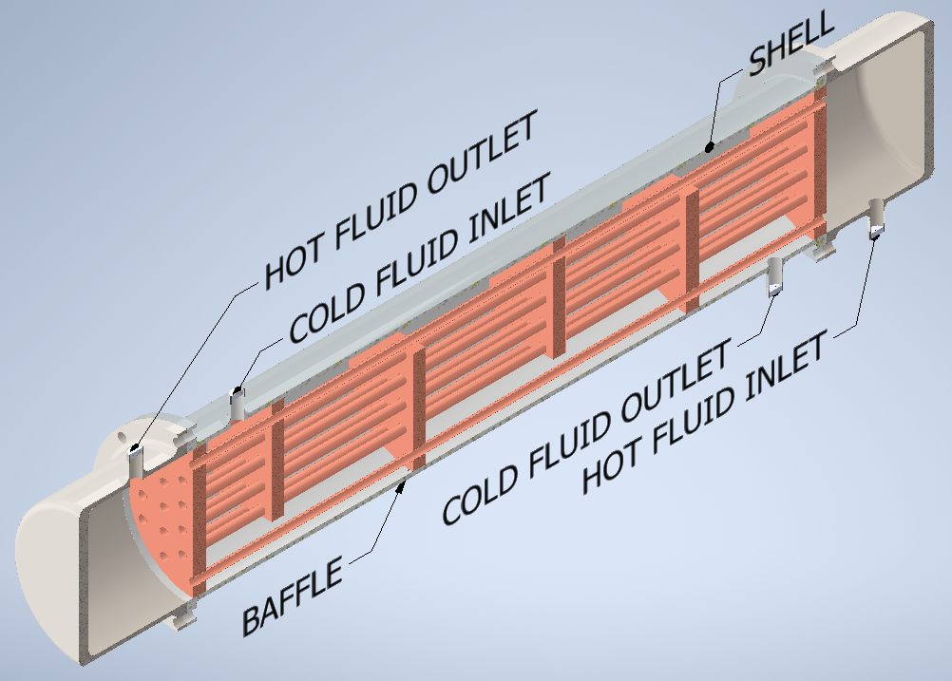
What is a Shell and Tube Heat Exchanger?
A Shell and Tube heat exchanger is a simple system that transfers heat by running cool and hot fluids in a series of pipes.
The shell is the outer portion of the system which is a large pressure vessel with a bundle of tubes running on the inside of the shell. Baffles are used to control the flow of the fluid inside the shell.
Heat is transferred using conduction through the bundle of pipes inside the shell and convection of the fluids.
Most commonly used in oil refineries and large chemical processes because of its high pressure applications.
Cross section of shell and tube model using Solidworks.

Slide 4
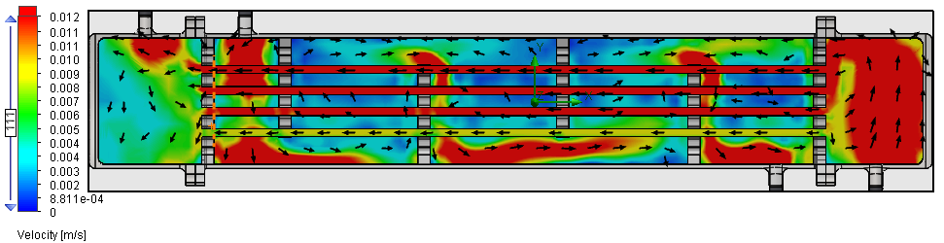
How does a Shell and Tube Heat Exchanger Work?
This is a single pass model which means the fluid in the tube bundle passes through the shell horizontally one time.
Conduction transfers energy through the walls of the pipe so the fluids do no mix.
Convection transfers energy throughout the fluid inside the system that the fluid is in.
This model has crossflow which means the fluid in the tube bundle flows in the opposite direction from the fluid in the shell.
The baffles direct the fluid in the shell across the tube bundles in a zigzag formation increasing turbulent flow for more cross-flow and mixing inside the shell.
Vector model of flow direction.

Slide 5
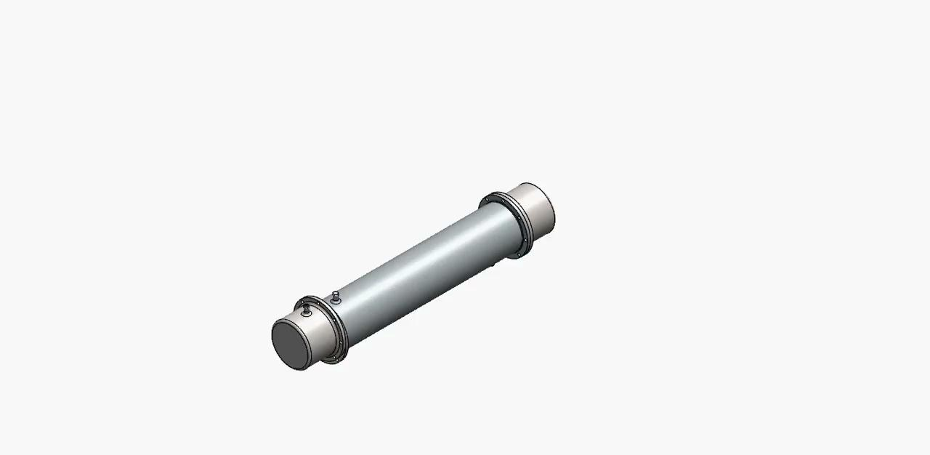
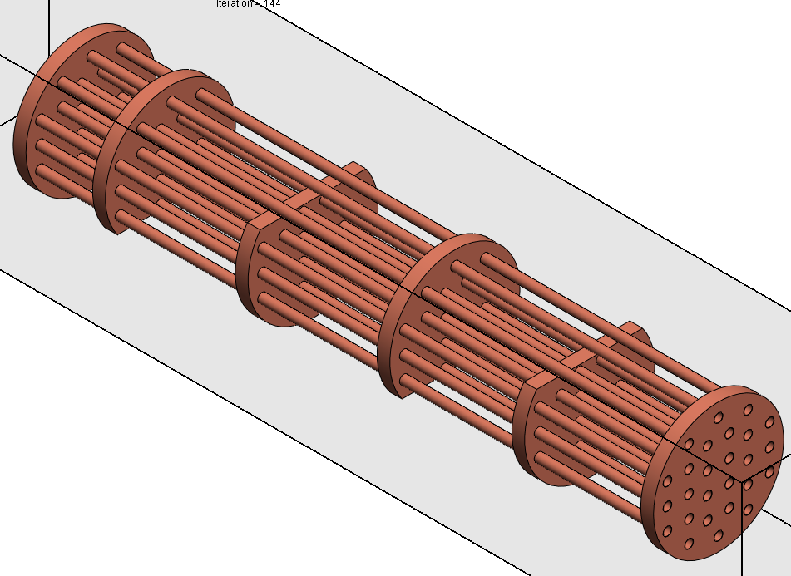
View of Shell and Tube Heat Exchanger
Shell and Tube break down.
Isometric view of tube bundle and baffles.

Slide 6
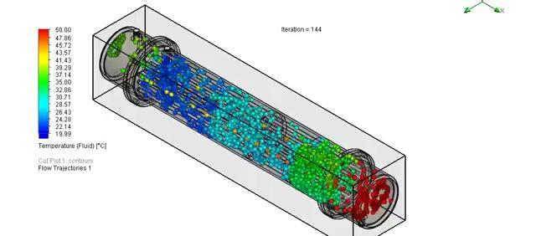
Simulation of Heat Transfer in System

Slide 7
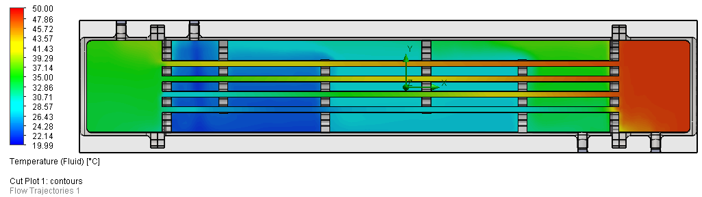
What Results did the Shell and Tube Produce?
The overall heat transfer for the heat exchanger was found to be Q_{actual} =2.32 kW. The theoretical heat transfer was Q_{theoretical}= 6.27 kW giving us an effectiveness of .37.
Initial conditions: Cold Inlet = 20°C
Hot inlet = 50°C
From the heat transfer the temperature exchange provided us with final values of the TCO being 31.12°C and the THO being 38.93°C
Temperature distribution of the fluids across the heat exchanger.

Slide 8
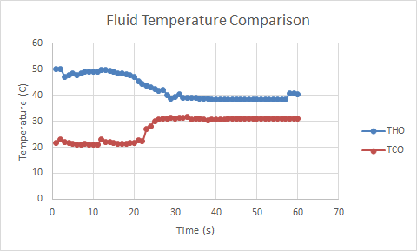
What do these Results Mean?
The temperature of the fluid drops as it travels through the tube exit.
Counter-flow allows for the most heat transfer to occur because the cold fluid flows across the hot fluid inlet.
Temperature change over time.

Slide 9
Conclusion
Solidworks is a great tool when running 3D visual simulation.
Solidworks is also a great tool when running programs numerically.
Shell and tube heat transfer has an overall equal temperature distribution.
Through trial and error we were able to get an efficiency of 37%.
With a simulation there will not be any uncertainty.
List of applications: HVAC, Refrigeration, and compressors.

Slide 10

Video Presentation

Slide 11
Any Questions?

